Slide 1
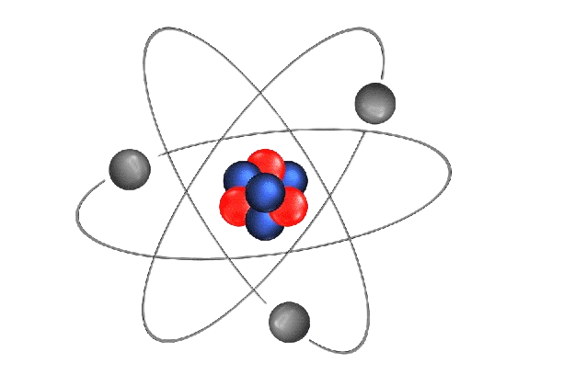
Particle physics event classification
By
Chethan

Slide 2
contents
Introduction
Objective
Data Preprocessing
Challenges
Machine Learning Models
Conclusion

Slide 3
INTRODUCTION
Particle Physics
Particle Physics studies the smallest building blocks of the universe and their interactions
Data Science

Slide 4
INTRODUCTION
Background
Accurate classification crucial in particle physics for understanding fundamental particles and interactions.
Data Science

Slide 5
Objective
Build a machine-learning model to classify events into Signal (s) and Background (b) categories.
Data Science

Slide 6
DATASET
EventId | DER_mass_MMC | DER_mass_transverse_met_lep | DER_mass_vis | DER_pt_h | DER_deltaeta_jet_jet | DER_mass_jet_jet | DER_prodeta_jet_jet | DER_deltar_tau_lep | DER_pt_tot | DER_sum_pt | DER_pt_ratio_lep_tau | DER_met_phi_centrality | DER_lep_eta_centrality | PRI_tau_pt
100000 | 138.47 | 51.655 | 97.827 | 27.98 | 0.91 | 124.711 | 2.666 | 3.064 | 41.928 | 197.76 | 1.582 | 1.396 | 0.2 | 32.638
100001 | 160.937 | 68.768 | 103.235 | 48.146 | -999 | -999 | -999 | 3.473 | 2.078 | 125.157 | 0.879 | 1.414 | -999 | 42.014
100002 | -999 | 162.172 | 125.953 | 35.635 | -999 | -999 | -999 | 3.148 | 9.336 | 197.814 | 3.776 | 1.414 | -999 | 32.154
100003 | 143.905 | 81.417 | 80.943 | 0.414 | -999 | -999 | -999 | 3.31 | 0.414 | 75.968 | 2.354 | -1.285 | -999 | 22.647
100004 | 175.864 | 16.915 | 134.805 | 16.405 | -999 | -999 | -999 | 3.891 | 16.405 | 57.983 | 1.056 | -1.385 | -999 | 28.209
100005 | 89.744 | 13.55 | 59.149 | 116.344 | 2.636 | 284.584 | -0.54 | 1.362 | 61.619 | 278.876 | 0.588 | 0.479 | 0.975 | 53.651
PRI_tau_eta | PRI_tau_phi | PRI_lep_pt | PRI_lep_eta | PRI_lep_phi | PRI_met | PRI_met_phi | PRI_met_sumet | PRI_jet_num | PRI_jet_leading_pt | PRI_jet_leading_eta | PRI_jet_leading_phi | PRI_jet_subleading_pt | PRI_jet_subleading_eta | PRI_jet_subleading_phi | PRI_jet_all_pt | Weight | Label
1.017 | 0.381 | 51.626 | 2.273 | -2.414 | 16.824 | -0.277 | 258.733 | 2 | 67.435 | 2.15 | 0.444 | 46.062 | 1.24 | -2.475 | 113.497 | 0.002653 | s
2.039 | -3.011 | 36.918 | 0.501 | 0.103 | 44.704 | -1.916 | 164.546 | 1 | 46.226 | 0.725 | 1.158 | -999 | -999 | -999 | 46.226 | 2.233584 | b
-0.705 | -2.093 | 121.409 | -0.953 | 1.052 | 54.283 | -2.186 | 260.414 | 1 | 44.251 | 2.053 | -2.028 | -999 | -999 | -999 | 44.251 | 2.347389 | b
-1.655 | 0.01 | 53.321 | -0.522 | -3.1 | 31.082 | 0.06 | 86.062 | 0 | -999 | -999 | -999 | -999 | -999 | -999 | 0 | 5.446378 | b
-2.197 | -2.231 | 29.774 | 0.798 | 1.569 | 2.723 | -0.871 | 53.131 | 0 | -999 | -999 | -999 | -999 | -999 | -999 | 0 | 6.245333 | b

Slide 7






DATA PREPROCESSING
Step 1
Step 2
Step 3
Step 4
Step 5
Step 6
Handling Missing Data
Data Cleaning
Feature Engineering
Dealing with Categorical Data
Data Splitting
Standardization
Data Science

Slide 8
Challenges & difficulties
Imbalanced data
Outliers/Error
Overfitting
Target column Data was imbalanced with 70-30 ratio
Under-sampling method is used to balance the data
-999 value was found in the data set which was considered as missing value.
All features with more than 30% missing value was removed
Other Few of the outlier value was removed
Almost all the models were overfitting
L2 regularization and estimators were used to avoid the overfitting
Data Science

Slide 9
Handling Missing Data
Identify and handle missing values in the dataset.
Data Cleaning
Address any inconsistencies or errors in the dataset, -999 error found
Correct or remove outliers that may negatively impact model performance.

Slide 10
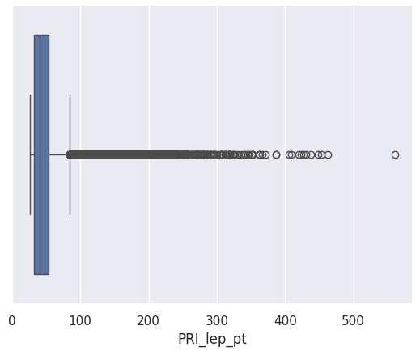
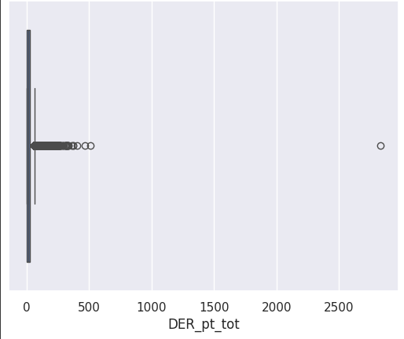
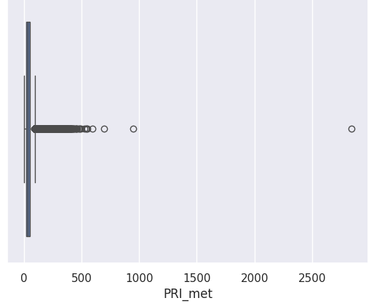
DATA PREPROCESSING
Feature Engineering
Removing irrelevant or redundant features that do not contribute meaningful information
Features with more than 30% missing values are dropped and event id feature is dropped.
DER_deltaeta_jet_jet
DER_mass_jet_jet
DER_prodeta_jet_jet
DER_lep_eta_centrality
PRI_jet_leading_pt
PRI_jet_leading_eta
PRI_jet_leading_phi
PRI_jet_subleading_pt
PRI_jet_subleading_eta
PRI_jet_subleading_phi
EventId
Data Science

Slide 11
DATA PREPROCESSING
Dealing with Categorical Data
Converting categorical variables into a format suitable for machine learning models. (Target feature)
Since data is imbalanced, data is balanced first, using under-sampling method
=1
=0
Data Science

Slide 12
DATA PREPROCESSING
Data Splitting
Divide the dataset into training, and testing sets to evaluate the model's performance on unseen data.
80%-20% splitting is done
Normalization/Standardization
Scale numerical features to a standard range to prevent certain features from dominating others
Standard scaler is used in this dataset
Data Science

Slide 13
Machine Learning Models
Logistic Regression
Kneighbors Classifier
XGBoost
Naive Bayes Theorem
87%
88%
94%
80%
Accuracy
Accuracy
Accuracy
Accuracy
Data Science

Slide 14
Machine Learning Models
Random Forest Classifier
Stacking Method
97%
98%
Accuracy
Accuracy
Data Science

Slide 15
Model Accuracy

Slide 16
Final Stacking model
Cross-Validation Scores (Accuracy): [0.981349 0.98116651 0.98222498 0.97992481 0.98160383]
Mean Cross-Validation Accuracy: 98.13%
Standard Deviation of Cross-Validation Accuracy: 0.08%
Data Science

Slide 17
CONCLUSION
In this physics particle event classification project utilizing machine learning algorithms, we applied a range of models to predict and classify events into signal and background categories. The accuracy results obtained from different models provide valuable insights into the effectiveness of each algorithm.
Data Science

Slide 18
acknowledgement
I would like to thank Learnbay for providing this dataset
Data Science

Slide 19
THANK YOU
Chethan
chethan.kmr07@gmail.com
Data Science

